Slide 1
Holistic Admissions Diversity, Fairness, Excellence
Diana Meyer, DNP, RN, NEA-BC, FAEN
November 19, 2021
LPN to BSN Pilot Program Faculty Development Session
Notes:
Had the honor and pleasure of working with Mary during the development of the WWU RN to BSN program curriculum—representing practice while I was a clinical nurse specialist for PeaceHealth
A little more about my background—after completing my DNP at JHU I was recruited to SLHS in Idaho to lead the Center for Nursing Excellence—the Center’s programs included Nursing Research & EBP Fellowship Program, Nursing Peer Review, Writing Workshop, support for nurses’ professional advancement (certification and graduate education support), development of evidence-based nursing practice (12 CNS reported to me), NDNQI analysis and changes to practice based on findings-just to name a few

Slide 2
Today’s Journey
Why
History
Outcomes/Results
What
Definition
Components
How
Recommended steps
Implementation examples
Resources & Tools
Next Steps

Slide 4
History
Harvard University
Court Cases
Gratz v. Bollinger (2003)
Grutter v. Bollinger (2003)
Supreme Court rulings
Washington State Law (RCW 49.60.400)
The state shall not discriminate against, or grant preferential treatment to, any individual or group on the basis of race, sex, color, ethnicity, or national origin in the operation of public employment, public education, or public contracting
Notes:
Being a fan of things that are bizarre, baffling and bewildering—I came across an interesting article published in the New Yorker and written by Malcom Gladwell
Harvard wanted a certain type of student –
Protestant men from elite upbringings.
Arrival of the College Entrance Exam in early 1900’s
As the new basis for admissions, the entrance exam made the college dream possible for anyone with the grades and financial resources needed to attend. This led to a more diverse pool of applicants.
By 1922, Jewish students accounted for more that a fifth of Harvard’s freshman class. The rates were soaring because their scores on the entrance exam were astonishingly better than other applicants.
“Starting in the fall of 1922,” “applicants were required to answer questions on ‘Race and Color,’ ‘Religious Preference,’ ‘Maiden Name of Mother,’ ‘Birthplace of Father,’ and ‘What change, if any, has been made since birth in your own name or that of your father? (Explain fully).’ ”—holistic, but for the wrong year
2003—more recent history brings us challenges to affirmative action practices
Gratz v. Bollinger was a United States Supreme Court case ruled that the university's point system was too mechanistic and therefore unconstitutional.^{[1}
Grutter v. Bollinger, the United States Supreme Court upheld the affirmative action admissions policy of the University of Michigan Law School. The decision permitted the use of racial preference in student admissions to promote student diversity. The court officially described the strategy as “highly individualized, holistic review of each applicant’s file, giving serious consideration to all the ways an applicant might contribute to a diverse educational environment”

Slide 5
2020 Census
Decrease in white alone
State = -1.3%
King County = -4.0%
Notes:
Current snapshot of diversity in Washington State nursing workforce
Peek at what the 2020 Census tells us about the changing demographics in our state

Slide 6
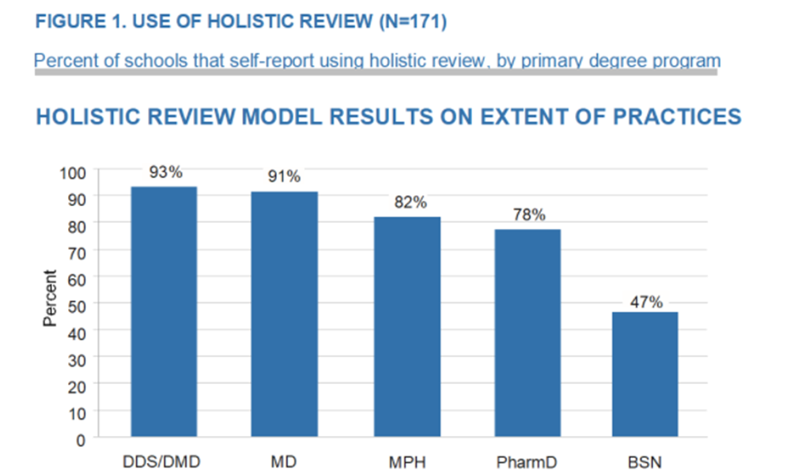
Pursuit of Diversity & Inclusion
Urban Universities for HEALTH Study (2014)
72% reported an increase in diversity and no change or an increase in student success measures
Notes:
Purpose was to determine the extent in which health professions schools at public universities have adopted holistic admissions review
Determine whether holistic admissions review resulted in an increase in the diversity of their students
Were any measurable changes in
academic quality of incoming students,
in student retention,
or in measures of student success since adoption of holistic review practices.
Wanted to gain a better idea of how schools were evaluating their admissions practices.

Slide 7
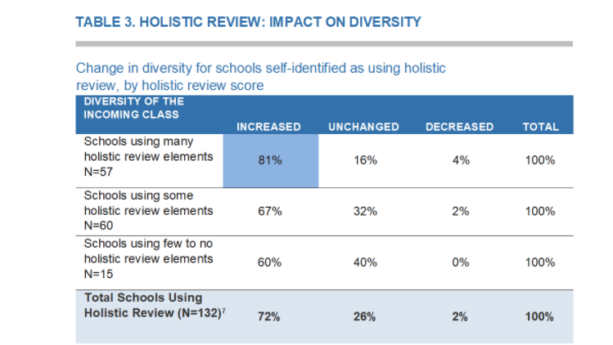
Urban Universities for HEALTH Study (2014)
⁷ Includes that self-identified using holistic review that track diversity outcomes
Notes:
Majority of schools reported an increase in diversity
Digging a little deeper, this table shows that schools with a high holistic review score (many elements of a holistic process) reported a greater increase in diversity that schools with a lower holistic review score (few or no elements )
Correlation is statistically significant suggesting that schools implementing many elements of holistic review is more likely to result in an increase in diversity than are schools implementing only a few.

Slide 8
Survey of Nursing School Deans
REASONS FOR THE CHANGE AND EXISTING BARRIERS
Enable the school to shape the incoming class to better meet its mission and goals including increasing diversity Improve the chances that the school’s graduate would reflect the public they serve To address perceived problems with prior approaches To meet accreditation requirements In response to encouragement from university administration | Lack of knowledge or expertise regarding the implementation Concerns that faculty and staff would not have enough time to review applications Concerns that the process would not be as sufficient as the current process
Reasons for making the change
Reasons for not making the change
Glazer, G., Clark, A., Bankston, K., Danek, J., Fair, M., Michaels,J. (2016). Holistic admission in nursing: we can do this. Journal of Professional Nursing,32(1) published online 12 January 2016. Retrieved from poster presentation found at https://sigma.nursingrepository.org/bitstream/handle/10755/16235/Glazer_PST248_90611.pdf?sequence=1&isAllowed=y
Notes:
The results for the nursing schools ignited a fire with a follow up study to Urban Universities for Health Study seeking to understand the barriers preventing schools of nursing to adopt holistic admissions review—survey of deans of nursing schools conducted.
What you see on the screen are the results
Not sufficient—Deans described a sense of uneasiness regarding acceptance, comparison, and potential retaliation if they were to implement holistic admissions review
Recommendations:
the need for a common definition (lack of shared definition was identified) and framework for holistic admissions review,
better dissemination of evidence,
the need for buy-in at all levels, and
the need for additional resources to implement holistic admissions review in nursing (including a toolkit and training).

Slide 9
American Association of Colleges of Nursing
2016
Began advocating for Holistic Admissions Review
2017
Nursing Workforce Diversity funding opportunity was released which included a provision for nursing schools to implement holistic admissions practices.
2018–2020
Holistic Admissions Review workshops
AACN
White Paper
Notes:
Moving ahead on the recommendations and the need for resources —AACN began by advocating for holistic admissions review process
As part of the Nursing Workforce Diversity funding, schools were required to engage with a professional organization for technical assistance and training. AACN has provided technical assistance and diversity training for 32 of the 34 grant-funded schools over the past three years.
Workshops also have been presented to 20 nursing schools in addition to the 64 workshops presented to the HRSA grant-funded schools.
White paper published in December 2020 : Promising Practices in Holistic Admissions Review: Implementation in Academic Nursing

Slide 10
Nursing School Outcomes
Example 2
Zerwic et al (2018) reported that minority admissions increased after implementation of holistic admissions from 41.4% to 55.6%
No significant changes in average admission science GPA, overall GPA, 2-year graduation rate or first time NCLEX pass rates
Example 1
% of Underrepresented Minority* Prelicensure Students Accepted per Cohort
Fall 2016 | Spring 2017 | Fall 2017 | Spring 2018 | Fall 2018 | Spring 2019
24.2 | 31.6 | 19.8 | 19.0 | 38.2 | 38.6
*African American, Hispanic, Native American, Pacific Islander, Vietnamese and male
Attrition rate remained steady at 1.5 to 2.0%
Rosenberg, 2019
Notes:
As we often find in the evidence—we don’t measure outcomes in the same way making it difficult to generate a comparison

Slide 11
Definition of Diversity
“Totality of the ways that people are similar and different, including race, ethnicity, class, gender, sexual orientation and identity, disability, national origin and citizenship status, age, language, culture, religion and economic status, particularly when those similarities and differences are used as a basis for unfair advantage and inequity. ”
University of Illinois at Chicago, 2012
Notes:
There is still a limited view of diversity---when one school of nursing surveyed students after the implementation of holistic admissions review it was clear that the majority of the students had a narrow definition limited to race and ethnicity. It will be critical as this work continues that a comprehensive definition of diversity is promoted to expand the understanding of current and future healthcare professionals

Slide 12
Definition of Holistic Admission Process
“A flexible, individualized way of assessing an applicant’s capabilities by which balanced consideration is given to experiences, attributes, and academic metrics.”
Association of American Medical Colleges (2010)
Notes:
Cognitive
Factual knowledge, memorization, and recitation that can be measured with standardized test
Non-cognitive factors
Grit and overcoming adversity
Variables relating to adjustment, motivation, and student perceptions
Combination of:
Traditional measures (GPA, test scores)
Attributes-personal qualities
Variables important to the field
Life experiences
EAM (experience, attributes, metrics)

Slide 13
Core Principles
Selection criteria are broad-based and linked to school mission, visions, and values
There is a balance of applicant experiences, attributes, and academic metrics
Admissions staff and committee members consider how each applicant may contribute to school learning environment and to the profession
Race and ethnicity may be considered only when such consideration is narrowly tailored to achieve mission related educational interests and goals associated with student diversity*
* RCW 49.60.400
Notes:
Balance is based on
Promoting diversity as an essential element to achieving excellence
Assessing applicants with goal of creating diverse selection pool and student body
Data that provide evidence supporting the use of selection criteria beyond grades and test scores
Think about what qualities make up the nurse we want to care for our loved ones, the community, want as a colleague; qualities create nursing excellence (empathy, courage, creativity, humor, resilience). Holistic admission process brings these “intangible” elements forward.

Slide 14
EAM: Experiences Attributes Metrics
With adversity(economic, educational, ethnic/cultural, family)
Paid or volunteer healthcare experience
Rural resident
First generation college student
Underrepresented minority
Leadership experience
Experience with diverse or underserved populations
B/C grades while working full time or caring for family
Veteran status
Notes:
Applicant experiences refer to those lived events or encounters that may result in knowledge acquisition or practical wisdom and provide important data in the holistic admissions process.
Life experiences may include
community service,
healthcare experience, or
leadership that contributed to personal growth.
Difficult personal, family, or social experiences and how the applicant dealt with those challenges may provide evidence of “grit” or perseverance.
Some schools have found that students with varsity athletic experience have the ability to be organized, handle a demanding schedule, and understand the importance of working with teams.

Slide 15
EAM: Experiences, Attributes & Metrics
Commitment to social justice
Oral communication
Written communication
Values that align with the profession
Motivational fit for the profession
Ability to tolerate stress
Ability to learn from experiences
Gender
Older than 25
Foreign language ability
Origin in a community that is a health professions shortage area
Origin in a geographic location specifically targeted by the school
Other attributes specific to the school’s mission, geographic context, and workforce needs
Notes:
.
Some of these are more global—apply to the attributes we want in all nurses (communication skills, values that align ability to tolerate stress)
Others may be more specific to a particular school and communities need (origin in community with nursing shortage, a specific geographic area such as rural)

Slide 16
EAM: Experiences, Attributes, Metrics
Overall GPA
Science GPA
Standardized Tests
Additional degrees
Notes:
And not to be forgotten—as these are an important part of the decision process
Test of Essential Academic Skills (TEAS)
TEAS
SAT/ACT
GRE
TOEFL

Slide 17
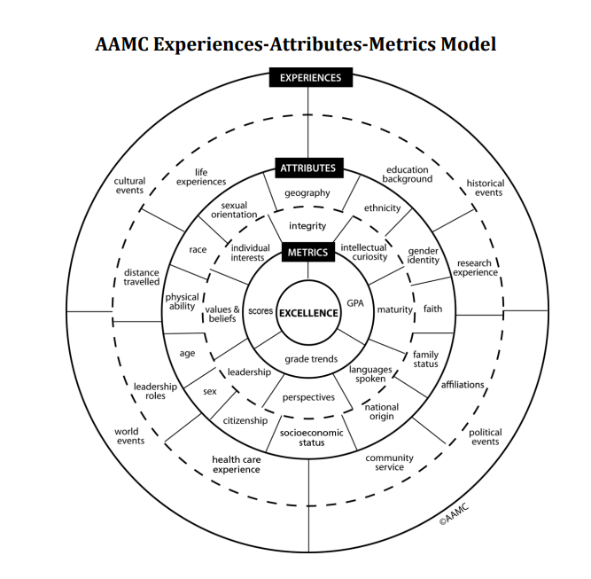
Retrieved fromHolistic-Review-Workbook.pdf (aacnnursing.org)
Adapted from Workforce America: Managing Employee Diversity as a Vital Resource, McGraw Hill Publishing, 1990.
Notes:
Graphic illustrating an organization of the EAM

Slide 18
Where to Start

Slide 19
Express value of diversity in mission, vision, values, and strategic goals
Solid stakeholder support at all levels
Administration
Faculty
Admissions staff
Accrediting bodies and nursing community
Healthcare (employers, hospital association)
Community

Slide 20
Address Issue of Faculty Time
“Although additional faculty time may be required, it has been our experience that faculty enjoy the personal nature of these interactions with applicants and their contribution to the shaping of the incoming class”
Rosenberg, 2019
Notes:
A corollary to gathering stakeholder support--No way around it—done well, it will take more time…primarily related to the design of your interview process
Also need to prepare faculty—several of the nursing programs referenced here used the AACN workshops as a preparation pathway
Not only is preparation important for faculty to understand the concept of holistic admissions and how to implement the steps in the process, but the very real risk of bias (how to identify and mitigate) must be addressed during the preparation of faculty

Slide 21
Define Experiences, Attributes, & Metrics (EAM)
Must have a common agreed upon understanding of which non-cognitive variables are important to create the diversity sought in the student body
Each must have a descriptor that defines how the applicant meets the expectation
Determine how to measure them
Yes, no
Exceeds, meets, below standard
Numeric value
Create the metric floor
Notes:
Considered a critical paradigm shift in thinking—not a metric ceiling, but a metric floor (GPA, standardized tests) that is essential to academic success
It is moving away from the priority of high metrics as most important selection criteria to a more balanced consideration of metrics, experiences, and attributes to choosing who will be successful in nursing and bring value to the profession

Slide 22
Implement Modalities to Collect Data
Forms
Essay
Interview
Notes:
Interviews can confirm that candidate is mature, understands the work of nursing and rigors of the program, has a caring attitude toward others and flexibility and perseverance to succeed.
Provide an opportunity to assess oral communication skills (verbal and nonverbal) and situation-based questions help assess applicants critical thinking skills.
You want to align interview questions to meet the profession and your program’s values
Decide on your methods of interview process (one to one, group, multiple mini-interviews, video/recorded)
Automate where you can

Slide 23
Desirable Traits to Applicant Data
Desirable traits of a nurse | Applicant data and source
Intellectual ability | Academic record, SAT or ACT score, and demographics University application
Commitment to service | Engagement or participation in service activities from letters of reference and/or essay
Cultural sensitivity | Interview and/or essay question
Empathy | Letters of reference
Capacity for growth | Overcoming adversity: interview question
Emotional resilience | Life experiences: interview question
Strength of character | Letters of reference, interview questions and/or essay
Interpersonal skills | Interview and letters of reference
Curiosity and engagement | Letters of reference
Advocacy for self, others, or a cause | Interview question
Ethical comportment | Interview question
Nursing work fit with career aspirations | Interview question
Adapted from Witzburg, R. A. & Sondheimer, H.M. (2013). Holistic review: Shaping the medical profession one applicant at a time. New England Journal of Medicine, 368 (17), 1565-1567
Jung D. et al 2021
Notes:
Organization of attributes to data needed and source of data

Slide 24
Recorded Interview Process
Ethics Advocacy Resilience Role of the nurse
30 seconds to read prompt and 90 seconds to respond
Rubric evaluated if applicant had
A main idea
Support for main idea
Somewhat detailed information to back up their thoughts
A clear presentation
Four Questions
Jung, et al (2021)
Notes:
Total time it took for reviewer to listen to and rate each interview was approximately 2-4 minutes—not a great deal of time on the surface—but a large applicant pool will still take more time a process without interviews

Slide 25
Group Interview Process
3 faculty interview a group of 5 applicants
Each applicant responded to 5 interview questions in a round-robin format
Within the group
Each question asked once
Each applicant had an opportunity to be first to answer
Used situational questions
Oregon Health & Science University School of Nursing
Notes:
Faculty surveyed after implementation
77% “strongly agreed” or “agreed” that “interviewing enhanced the admission process”
79% indicated that situation-based questions helped assess applicants’ critical thinking.
All respondents indicated interviewing provided an opportunity to assess oral communication skills (verbal and nonverbal), and 57 percent “strongly agreed” or “agreed” that “interviewing is worth the time invested.”

Slide 26
Multiple Mini Interviews
Circuit interview format
6 to 8 stations
Validated prompts to specifically address an attribute of interest
Allotted 2 minutes to read prompt and 6 to 8 minutes to respond
Notes:
Wagner et al reported the results of implementing the MMI process within the University of Cincinnati College of Nursing.
28% (n = 96) of the applicants offered admission under the holistic process that included the MMI model would not have been offered admission prior to the addition of the MMI model interview to the admission process.
MMI process increased the number of students identified as nonwhite, male, first-generation college student, or as coming from out of state as compared with the same applicants who would have been admitted on quantitative metrics alone
Applicants were surveyed after process and a majority(89%) believed the MMI model experience allowed an opportunity to demonstrate good fit to the CON program beyond what an application process allowed and 83% agreed the process was a fair assessment of personal characteristics and abilities.

Slide 27
Example of What and When
 | Experiences | Attributes | Academic metrics
Assessed at initial screen | Experiences with adversity (economic, educational, ethnic/cultural, family) Paid or volunteer healthcare experiences Coming from host campus (for regional campus applicants) State resident Rural resident First generation college student Underrepresented minority |  | GPA Completion of specific prerequisites by application deadline Additional degrees Completion of chemistry
Assessed at Interview | Leadership experiences Experience with diverse or underserved population | Commitment to Social Justice Oral Communication Written Communication Values that align with the profession Motivational fit for the profession Ability to tolerate stress Ability to learn from experiences
Wros, P. & Noone, J. (2018)
Notes:
Another example of organization of EAM and when/where it is assessed during the holistic admissions review process

Slide 28
Scoring Rubric for Essays
Diversity scoring:
Points | Criteria
1 | SELF: Either talks only about self or makes no mention of inclusivity or diversity
2 | OTHERS: Goes beyond self, includes immediate circle of understanding, demonstrates understanding beyond self
3 | GLOBAL: Broad demonstration, beyond immediate community
Lewis L. et al (2021)
Notes:
This school of nursing does not use interview process---one of the reasons cited was travel expenses for applicants—in today’s environment with comfort and skill in using zoom or teams, does this concern still exist?
Prompts used for personal essay statements are:
Why do you want to be a nurse
Give a specific example of a conflict or challenge you have experienced where you used critical thinking skills to resolve
Your patients may not share the same ethnicity, culture or set of values as you do, describe a personal scenario that challenged your core values and explain how you responded
What unique contribution will you make to the program and the profession of nursing

Slide 29
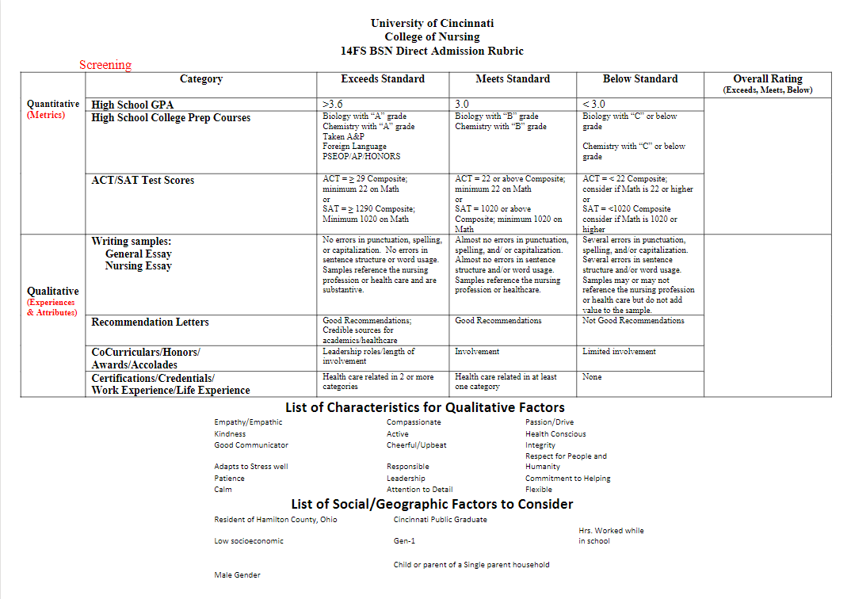
http://urbanuniversitiesforhealth.org/media/documents/BSN_Direct_Admission_rubric-FINAL.pdf
Notes:
You will find in several of the articles in the bibliography that the details of the scoring rubric are not shared—just general information about the rubric.
Rubric example—this one does give details about what qualifies for an exceed, meets, or below standard for each EAM

Slide 30
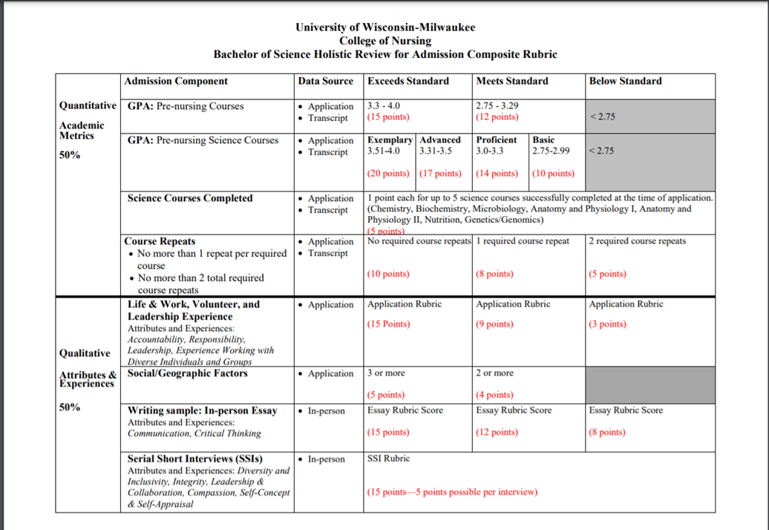
https://uwm.edu/nursing/wp-content/uploads/sites/287/2019/11/Rubrics-for-Admission.pdf
Notes:
This one adds the percentage of score that comes from quantitative and from qualitative and the data source

Slide 31
Resources
Holistic Admissions Tool Kit (aacnnursing.org)
Holistic Admissions | UW Graduate School
Navigating Holistic Admissions
Manual for Interviewers
Presentation for Prospective Students

Slide 32
AACN Holistic Admissions Toolkit
Notes:
Slide decks
Participant Guide & Workbook from AACN Holistic Review Workshop
Sample essay questions

Slide 33
UW Holistic Admissions Webpage
UW Holistic Review—Summary of Promising Practices
UW Graduate School Holistic Admissions Review
General information and salient literature for holistic admission standards
PowerPoint presentations
Evaluations for holistic admissions
Notes:
Two documents to help inform decisions and practices regarding holistic admissions review:
Slide deck on adapting during a pandemic
These are links to general resources that focus on different ways to evaluate the holistic admissions process

Slide 34
Navigating Holistic Admissions
Produced by ETS
Content in guide includes
Preparing for the Admissions Process
Collecting Applicant Information
Reviewing Applicant Files
Selecting Applicants
Evaluating the Admission Process
Notes:
Produced by ETS—the testing service -----obviously promotes the GRE as part of the process, but there is good information here

Slide 35
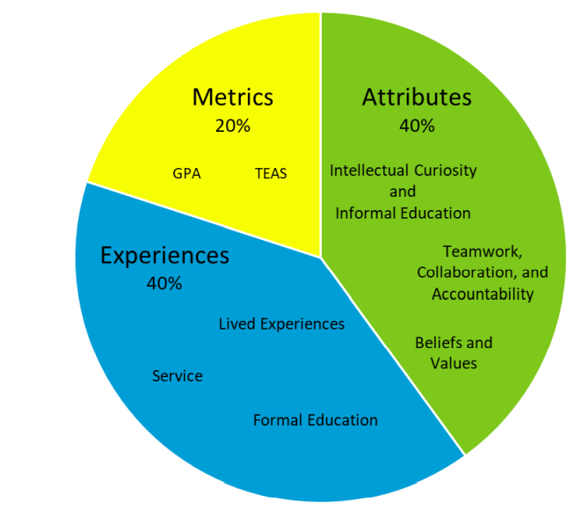
Manual for Interviewers
Michael G. DeGroote School of Medicine
Provides guidelines and approaches for using the Multiple-Mini process
Minnesota Alliance for Nursing Education
Holistic Admission PowerPoint – What is a Holistic Review?
Nursing Application Fall 2022 – Student Application Guide Sheet
Holistic Admissions Student Advising Tool – Fall 2022
Holistic Admissions Application – Definitions Supplement Sheet
Holistic Admissions Experiences, Attributes, and Metrics (EAM) Graphic
https://manemn.org/home/prospective-students/
Retrieved from https://manemn.org/wp-content/uploads/sites/6/2021/03/MANE-Holistic-Admission.March_.23.2021-1.pdf

Slide 36
Visibility of Holistic Admissions
https://nursing.lsuhsc.edu/care/admission.aspx

Slide 37
Notes:
Holistic admissions process is an important strategy to increase diversity in the nursing profession but should not be used in isolation. Reaching the goal of a diverse nursing profession requires a commitment to providing a safe and supportive learning environment which nurtures and supports your students
It is a dynamic, iterative process requiring frequent evaluation

